Slide 1



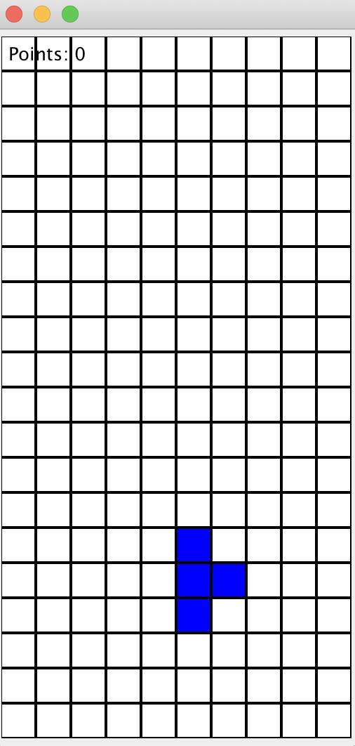
Tetris Game
Group 6 Khanh Phan, Shaista Usman, Yi Niu

Slide 2
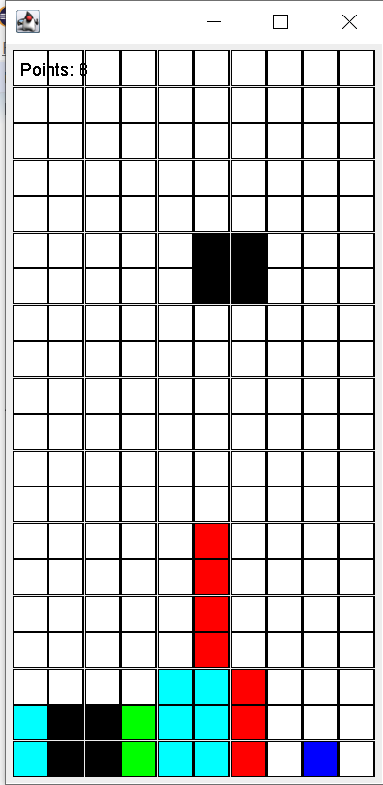
Tetris Game

Slide 3
JUnit Tests

Slide 5

Code Coverage Analysis

Slide 6
Code coverage

Slide 7
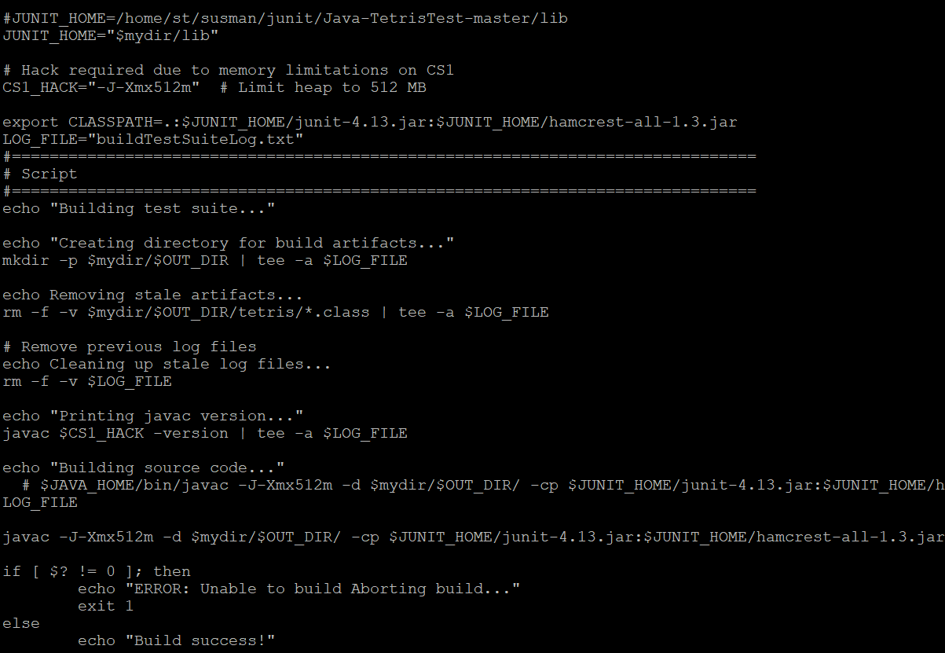
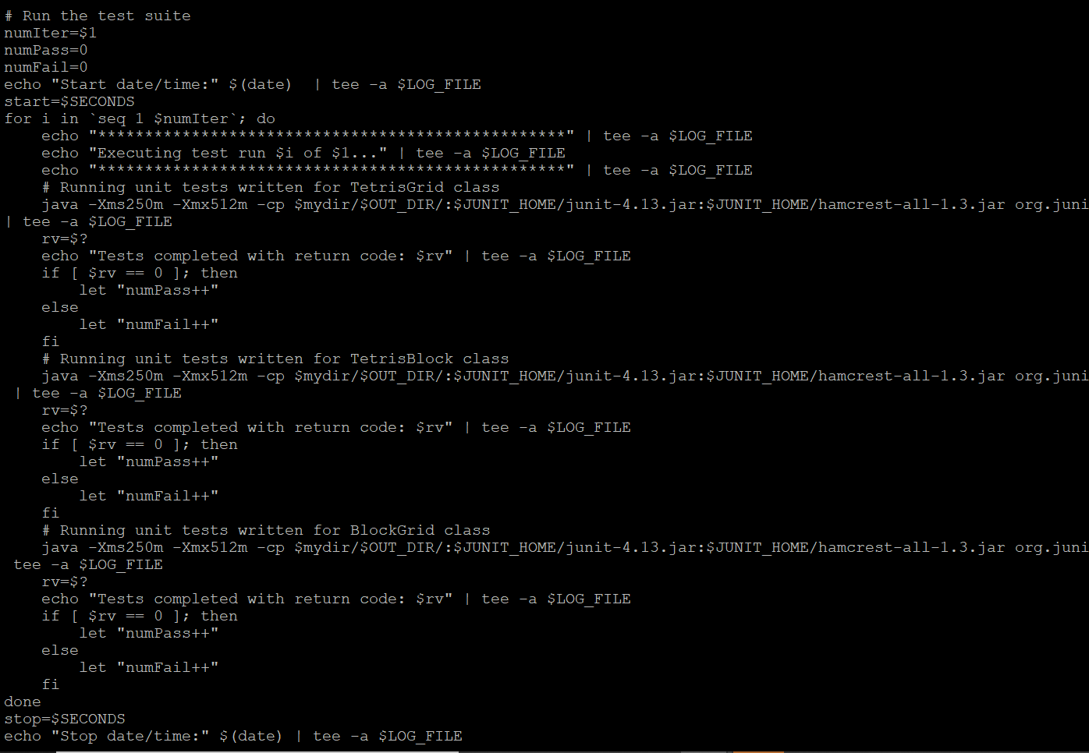
Building the Test Suite and Automating the Test Run

Slide 8
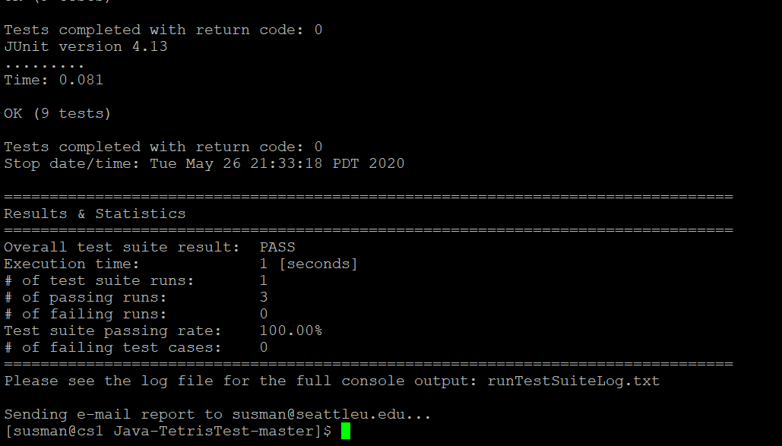
Execution of the TEST Suite

Slide 9
Code for Stress Testing

Slide 10
STRESS TESTING

Slide 11
Thank You!

